Slide 1
Topic 4: User Behaviour
(Part 2)
SOCIAL
INTERACTION
SECV2113 Human-Computer Interaction
Faculty of Computing
Universiti Teknologi Malaysia

Slide 2
BEING SOCIAL
01
FACE-TO-FACE CONVERSATIONS
02
REMOTE COLLABORATION AND COMMUNICATION
03
CO-PRESENCE
04
SOCIAL GAMES
05

Slide 3
BEING
SOCIAL

Slide 4
Social Interaction
We live together, work together, play together, talk to each other, and socialize
Social technologies developed to enable us to persist in being social when apart
They differ in how they support us
Some encourage social interactions (for example, family games with Alexa)
Others have a negative impact on everyday conversations (Turkle, 2015)

Slide 5
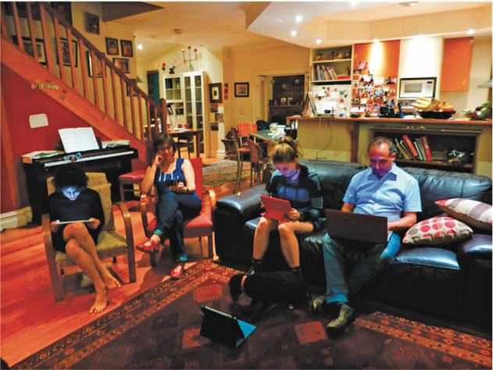
Are we spending too much time in our own digital bubbles?

Slide 6
Questions raised by social tech
Are in person conversations being superseded by social media interactions?
How many friends do you have on Facebook, LinkedIn, WhatsApp, and so on versus real life?
How much do they overlap?
How are the ways that we live and interact with one another changing?
Are the established rules and etiquette still applicable to online and offline?

Slide 7
FACE-TO-FACE
CONVERSATIONS

Slide 8
Conversational Mechanisms
Various mechanisms and ‘rules’ are followed when holding a conversation face-to-face such as mutual greetings
A: Hi there
B: Hi!
C: Hi
A: All right?
C: Good, how’s it going?
A: Fine, how are you?
C: OK
B: So-so. How’s life treating you?

Slide 9
Conversational Rules
Sacks et al. (1978) conversation analysis of conversations propose three basic rules:
Rule 1: The current speaker chooses the next speaker by asking an opinion, question, or request
Rule 2: Another person decides to start speaking
Rule 3: The current speaker continues talking

Slide 10
More Conversational Rules
Turn-taking used to coordinate conversation
A: Shall we meet at 8:00?
B: Um, can we meet a bit later?
A: Shall we meet at 8:00?
B: Wow, look at him?
A: Yes what a funny hairdo!
B: Um, can we meet a bit later?
Back channeling to signal to continue and following
Uh-uh, umm, ahh
Gets embedded

Slide 11
Further Conversational Rules
Farewell rituals
Bye then, see you, yeah bye, see you later….
Implicit and explicit cues
For instance, looking at watch or fidgeting with coat and bags
Explicitly saying, “Oh dear, look at the time, I must go, I’m running late…”

Slide 12
Breakdowns in Conversation
When someone says something that is misunderstood:
Speaker will repeat with emphasis:
A: “This one?”
B: “No, I meant that one!”
Also use tokens:
Eh? Quoi? Huh? What?

Slide 13
What happens in online conversations?
Do the same conversational rules apply?
Are there different kinds of breakdowns?
How do people repair them for:
Email?
Instant messaging?
Texting?
Skype or other videoconferencing software?

Slide 14
New Social Rules during COVID-19
For how to behave and interact with others when communicating via video conferencing
Muting yourself when not talking
Raising a yellow hand when wanting to speak
Other emoji reactions became commonly used to signify various forms of praise, emotions and non-verbal feedback, e.g.
clicking on the red heart and party hat icons that momentarily appear in someone’s window and then disappear after 10 seconds

Slide 15
Online Collaboration and Communication
Much research on how to support conversations when people are remote
Many applications have been developed
email, videoconferencing, instant messaging, chatrooms
To what extent do they mimic or move beyond existing ways of conversing?

Slide 16
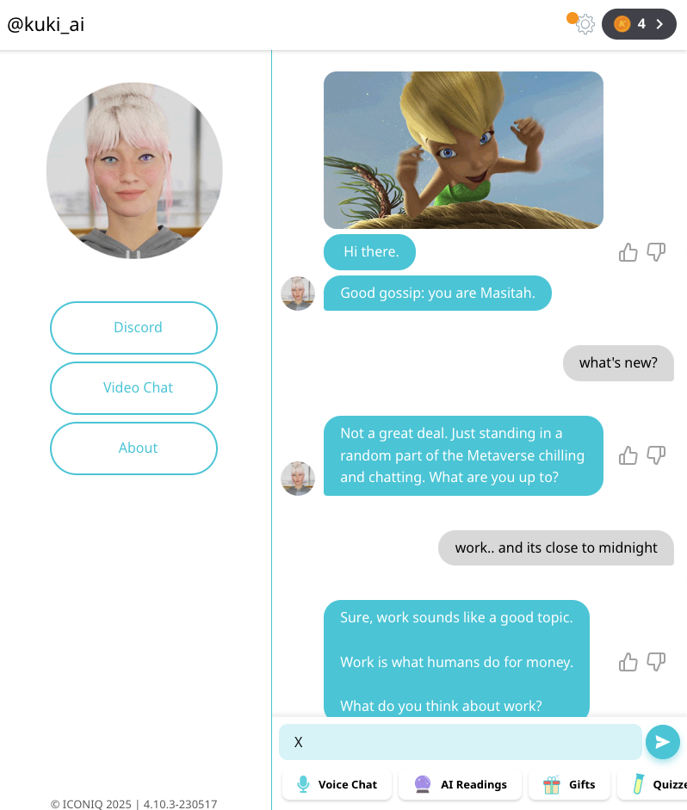
Talking with Chatbots
Conversational User Interfaces, such as chatbots, are more sophisticated in how they emulate turn-taking in conversations
e.g. Kuki.ai
Recent developments in AI are changing how we converse and interact with AI
e.g, ChatGTP

Slide 17
Dilemma: Is it OK to talk with a dead person using a chatbot?
Eugenia Kuyda lost a close friend in a car accident who was only in his 20s
She took all his texts sent over the course of his life and made a chatbot using them
Chatbot responds to text messages so that Eugenia can talk to her friend as if he was alive
Is this a creepy or comforting way to deal with grief?
Is it respectful of the dead person?

Slide 18
REMOTE
COLLABORATION &
COMMUNICATION

Slide 19
Early Videoconferencing: VideoWindow (Bellcore, 1989)
Shared space that allowed people 50 miles apart to carry on a conversation as if in same room drinking coffee together
3 x 8 foot ‘picture-window’ between two sites with video and audio
People did interact via the window, but strange things happened (Kraut, 1990)

Slide 20
Diagram of VideoWindow in Use

Slide 21
Findings of how VideoWindow System was used
Talked constantly about the system
Spoke more to other people in the same room rather than in other room
When trying to get closer to someone in the other place it had opposite effect—participants went out of range of the camera and microphone
No way of monitoring this

Slide 22
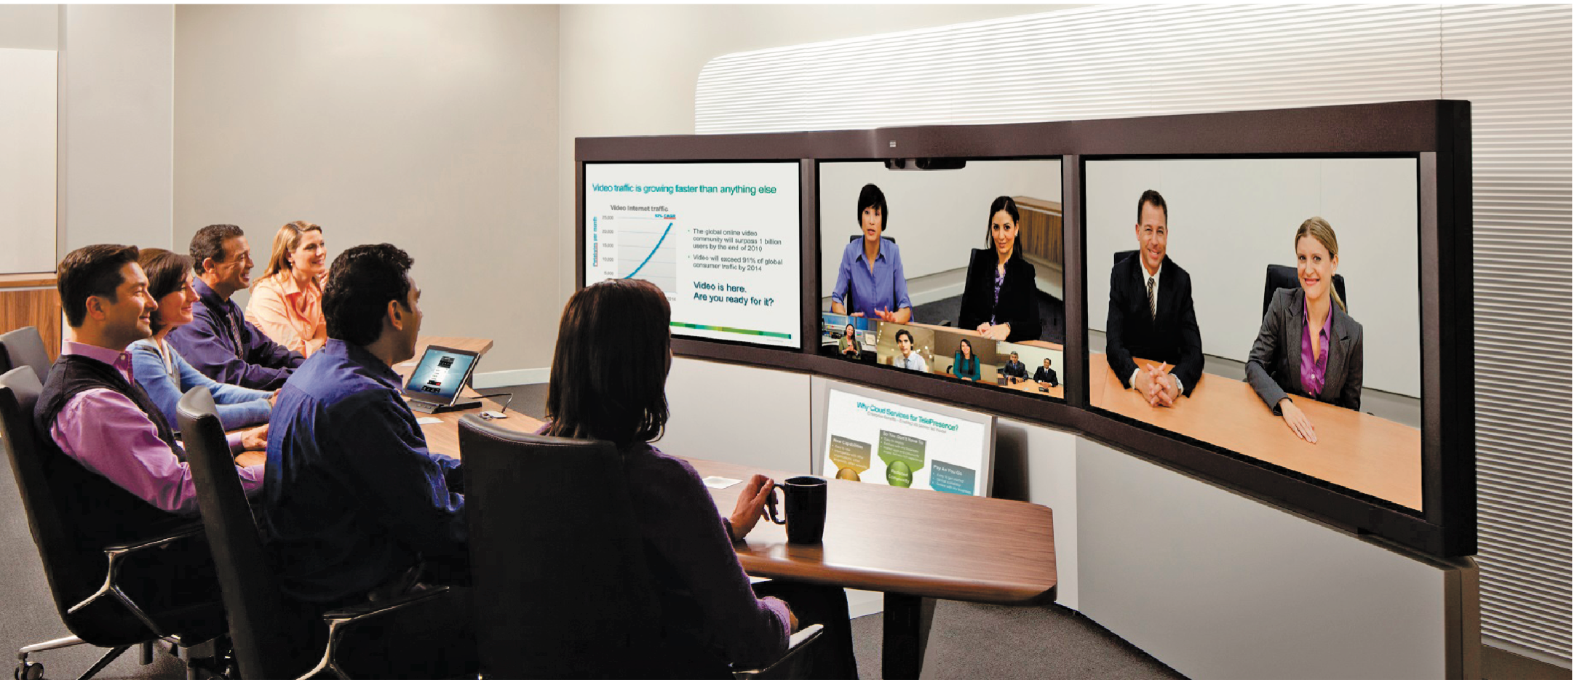
Videoconferencing and Telepresence Rooms
Many to choose from to connect multiple people (e.g. Zoom, Teams, Google Meet, Webex)
Customised telepresence rooms for groups

Slide 23
Current Videoconferencing
Webex, Zoom etc., have greatly extended how we communicate while providing tools to make is easier to switch between talking and working together
Zoom fatigue came into being (Bailenson, 2021)
excessive amounts of close-up eye gaze
intense cognitive load
increased self-evaluation from staring at a video of oneself
physically being in the same place for hours on end

Slide 24
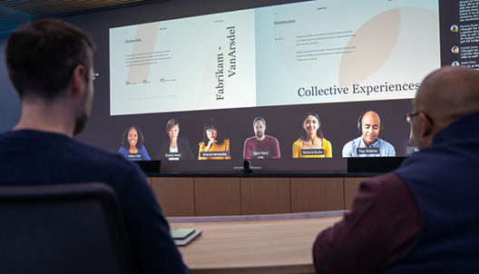
Microsoft Prototype of a Technology-enhanced Hybrid Meeting

Slide 25
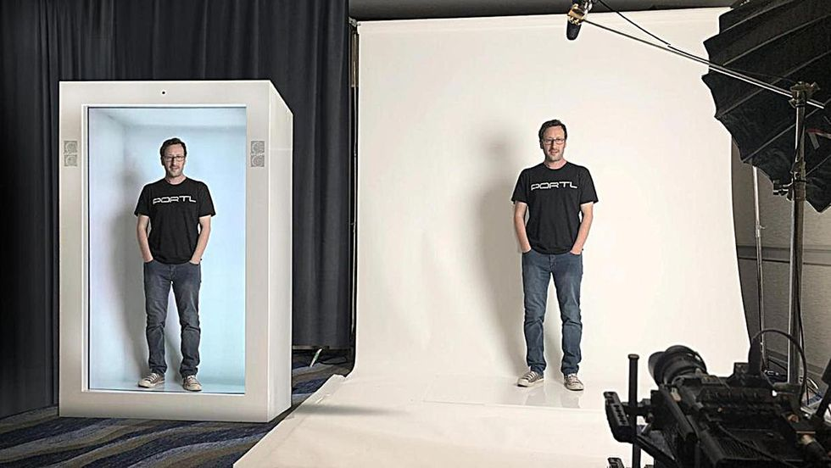
The future: 3D person in a box?
David Nussbaum demonstrating how they capture and present the Proto person in a box

Slide 26
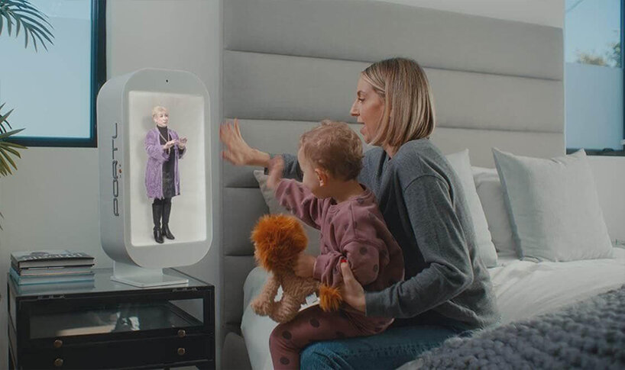
Proto M
Talking with a 3D video of granny in a box. The embedded camera at the top of the box faces the mother and child so that Granny can see and hear them in real time.

Slide 27
Telepresence and Social Presence
Telepresence refers to one party being present with another party, who is present in a physical space, such as a meeting room
Social presence refers to the feeling of being there with a real person when in virtual reality (VR)

Slide 28
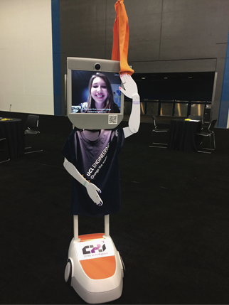

Telepresence Robots
Enable people to attend events who could not do so, such as by controlling their robot remotely
In places such as schools, conferences, and museums
Early example: Beam+
Often dressed up to appear like the person to others at the event
Positive experience of being there
Notes:
28

Slide 29
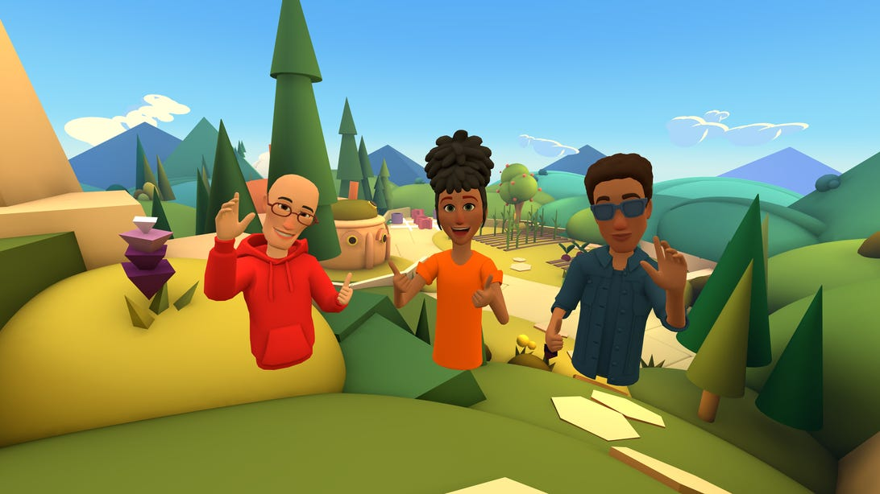
The Metaverse
Meta’s vision of three friends socializing in a 3D world represented as torso avatars
Users experience each other through donning VR headsets

Slide 30
How much realism and immersion are necessary…?
…in telepresence to make it compelling?
Telepresence rooms try to make remote people appear to be life-like
Use multiple high-definition cameras with eye-tracking features and directional microphones
Does FaceTime have as much presence as more high-definition settings?

Slide 31
Online Collaborative Tools
Now more commonplace in our everyday and working lives
e.g. the sharing of calendars, word processing, design and project management tools like Slack
Places for sharing knowledge
Tools like Miro, Figjam and Google Docs enable online collaborative creation and editing of reports, designs, etc.,

Slide 32
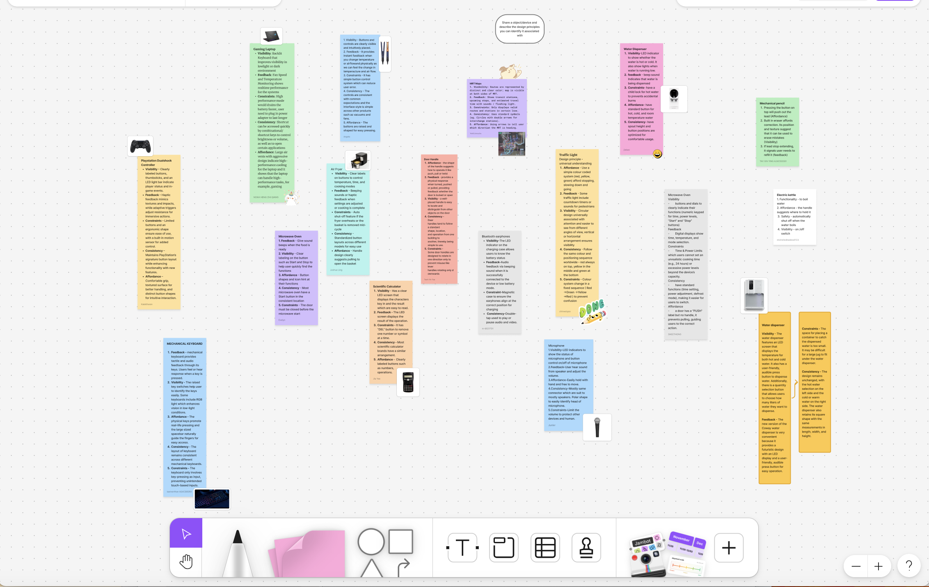
Collaborative Online Tools
Screen shot of a Figjam board used in an online class on Human-Computer Interaction where students upload their examples

Slide 33
CO-PRESENCE

Slide 34
What is Co-presence?
Co-located groups who want to collaborate
Many technologies have been designed to:
Enable groups to work, learn and socialise more effectively together
For example, tabletops, whiteboards, and public displays

Slide 35
Coordination Mechanisms
When a group of people act or interact together, they need to coordinate themselves
For example, when playing football or navigating a ship
To do so, they use:
Verbal and non-verbal communication
Schedules, rules, and conventions
Shared external representations

Slide 36
In Person Coordinating Mechanisms
Talk is central
Non-verbal also used to emphasize and as a substitute
e.g., nods, shakes, winks, glances, gestures, and hand-raising
Formal meetings
Explicit structures such as agendas, memos, and minutes are employed to coordinate the activity

Slide 37
Awareness Mechanisms
Involves knowing who is around, what is happening, and who is talking with whom (Dourish and Bly, 1992)
Peripheral awareness
Keeping an eye on things happening in the periphery of vision
Overhearing and overseeing—allows tracking of what others are doing without explicit cues
Situational awareness
Being aware of what is happening around you in order to understand how information and your actions will affect ongoing and future events
For example, air traffic control or an operating theatre

Slide 38
Shareable Interfaces
Designed to capitalize on existing forms of coordination and awareness mechanisms
Several studies investigating whether they help people to work together better, have found:
More equitable participation
More natural to work around
More comfortable sitting around a table than standing in front of a display

Slide 39
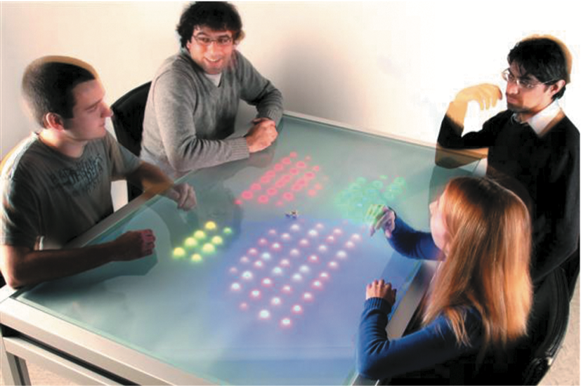
The Reflect Table
LEDs lit up to reflect how much each member of the group spoke
Used microphones in front of each individual to do this
Study showed those who spoke the most changed their behaviour the most
Those who spoke the least did not change their behaviour
Why do you think this is?
Notes:
An early prototype was the Reflect Table that was designed to monitor and analyze ongoing conversations using embedded microphones in front of each person and represents this in the form of increasing numbers of colored LEDs, as shown in Figure 5.15 (Bachour et al., 2008).
A study investigated whether students became more aware of how much they were speaking during a group meeting when their relative levels of talk were displayed in this manner and, if so, whether they regulated their levels of participation
more effectively. In other words, would the girl in the bottom right reduce her contributions (as she clearly has been talking the most) while the boy in the bottom left increase his (as he has been talking the least)?
The findings were mixed:
Some participants changed their level to match the levels of others, while others became frustrated and chose simply to ignore the LEDs. Specifically, those who spoke the most changed their behavior the most (that is, reduced their level), while those who spoke the least changed theirs the least (in other words, did not increase their level).
Another finding was that participants who believed that it was beneficial to contribute equally to the conversation took more notice of the LEDs and regulated their conversation level accordingly. For example, one participant said that she refrained from talking to avoid having a lot more lights than the others (Bachour et al., 2010). Conversely, participants who thought it was not important took less notice.

Slide 40
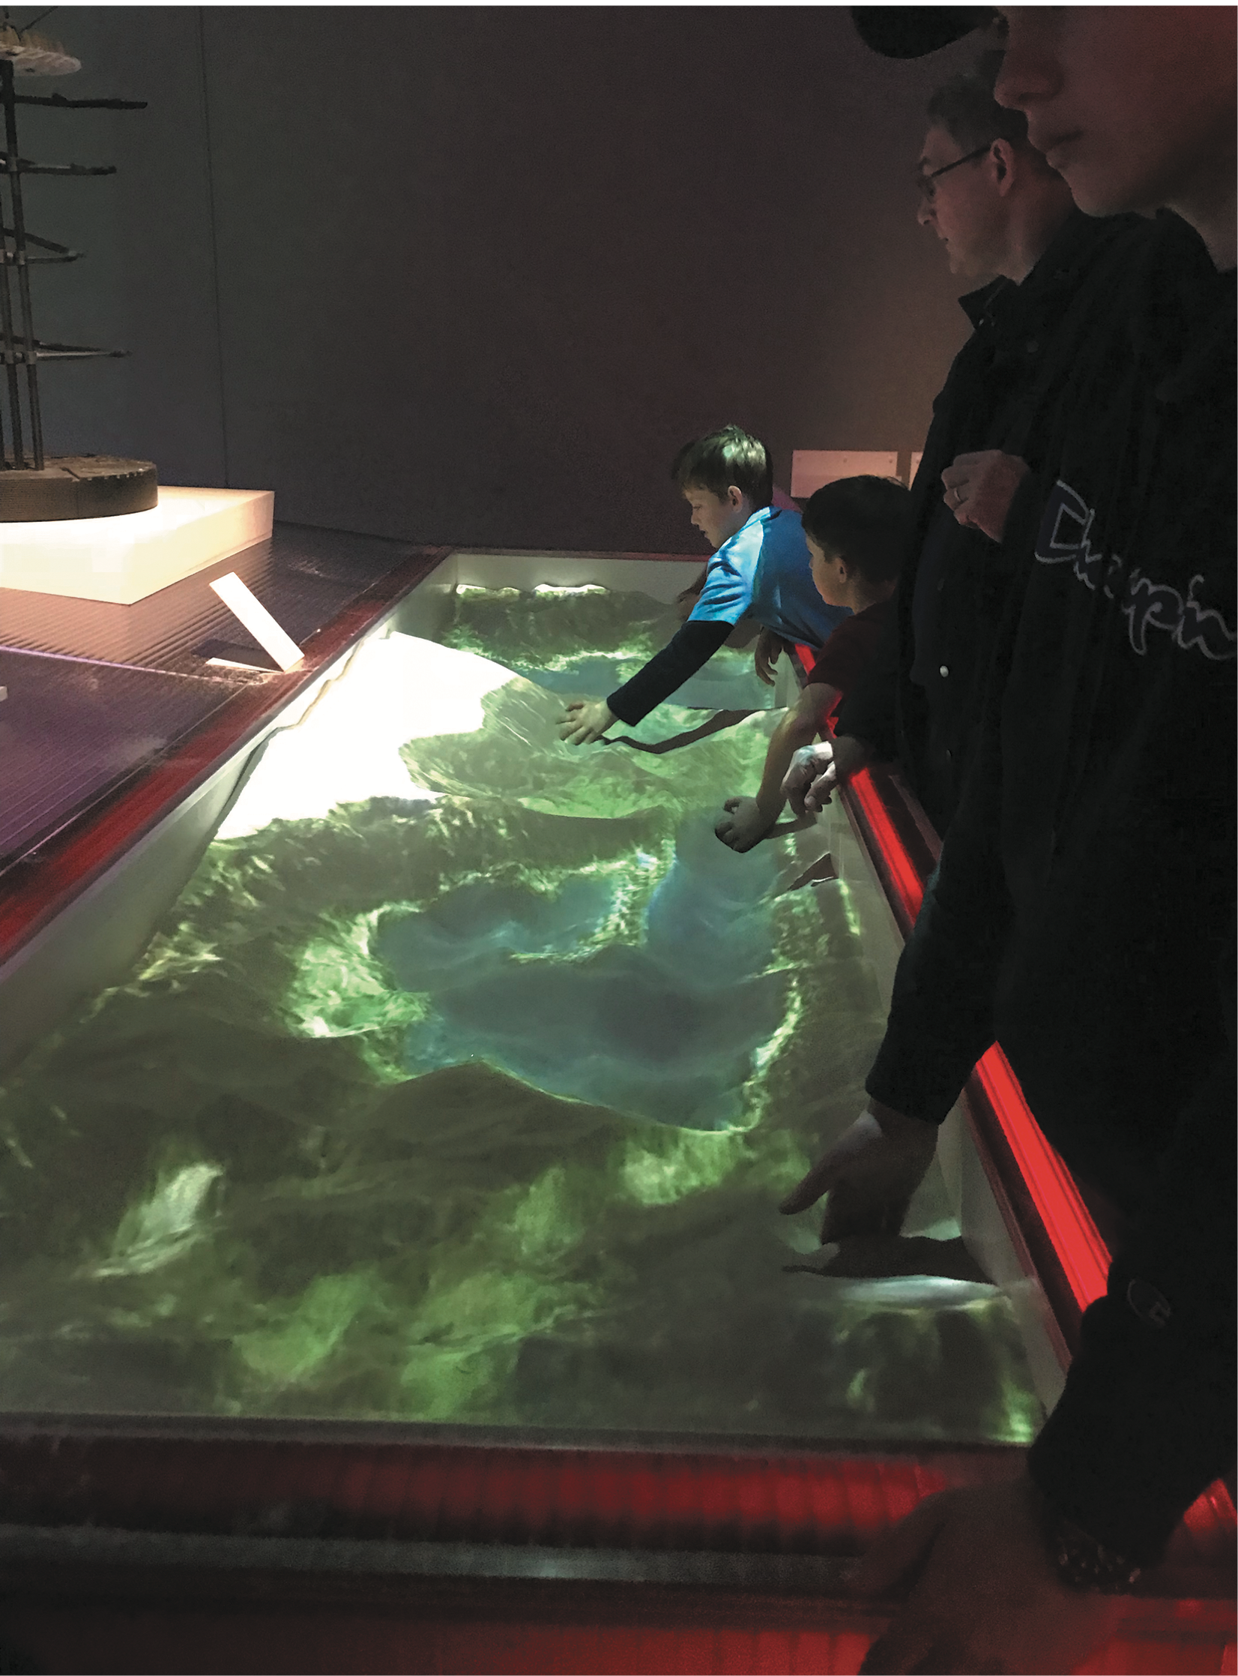
Playing Together in Same Space
Visitors using an AR sandbox at the V&A museum in London
Visitors sculpt landscapes out of sand
System reacts with changing superimposed digital colored landscape
Enables creative forms of collaboration
Notes:
Augmented reality (AR) sandboxes have been developed for museum visitors to interact with a landscape, consisting of mountains, valleys, and rivers. The sand is real, while the landscape is virtual.
Visitors can sculpt the sand into different-shaped contours that change their appearance to look like a river or land, depending on the height of the sand piles.
Figure 5.14 shows an AR sandbox that was installed at the V&A museum in London.
On observing two young children playing at the sandbox, this author overheard one say to the other while flattening a pile of sand, “Let’s turn this land into sea.”
The other replied, “OK,but let’s make an island on that. ”
They continued to talk about how and why they should change their landscape. It was a pleasure to watch this dovetailing of explaining and doing.

Slide 41
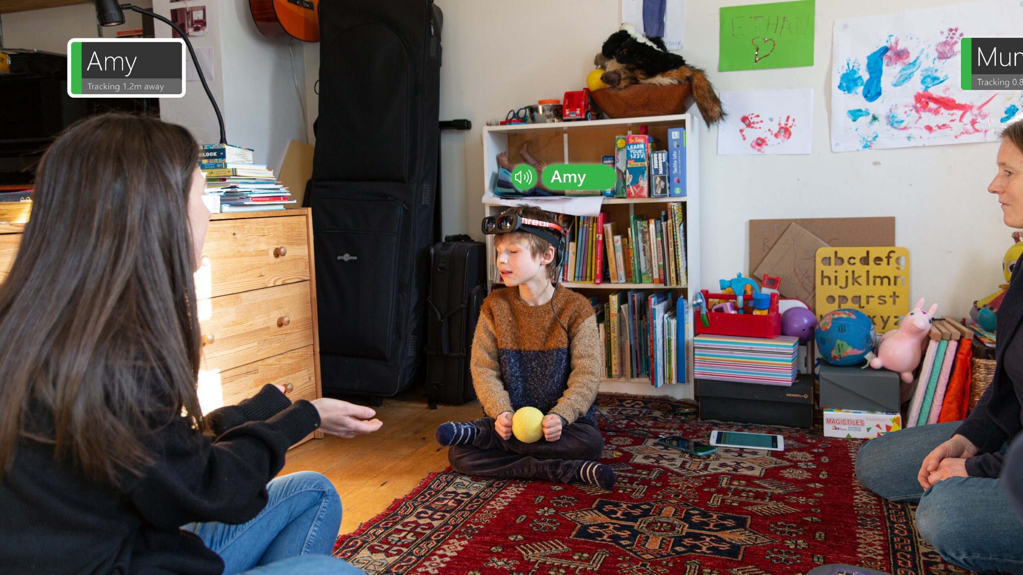
PeopleLens: A head mounted device that enhances a blind child’s spatial awareness of those around them
Video See PeopleLens in action: https://youtu.be/astmNfJHT4A.
Notes:
Cecily Morrison and colleagues (2021) developed PeopleLens (see Figure 5.16), a new wearable technology to help blind people make sense of and engage with their immediate
social surroundings.
It comprises a head-mounted augmented reality device that uses computer vision algorithms to locate, identify, track, and capture the gaze directions of people in the vicinity. It then presents this information to the wearer, when requested, through using spatialized audio so that it appears to come from the direction of the person.
When the child looks at someone, the head-mounted display reads aloud to them the name of that person. This kind of audio cue can help them understand and remember both
the relative position and distance of those around them.
The technology, in turn, indicates to those who have been seen by the technology, providing a replacement for the eye contact that usually takes place between people when they interact.
Cecily Morrison and her team (2022) at Microsoft are investigating whether these kinds of technological social presence help people develop a richer mental map of those around them.

Slide 42
SOCIAL
GAMES

Slide 43
Social Games
Designed to facilitate social interaction
Can be played indoors or outdoors, with and without technology.
examples include board games, tabletop games, and videogames (such as Minecraft)
Each player is aware of other players’ presence, their actions and how well they are playing

Slide 44
Social Online Games
Can involve creating a community, where competition, collaboration, peer pressure, rebellion, jealousy, and so on are all played out in their various forms
Matt Richetti (2022) has proposed three heuristics for evaluating them:
Does the social game involve synchronous or asynchronous player interaction, where players either chat with each other or they take turns.
Is the social interaction symmetrical or asymmetrical, in the sense that does forming a relationship require input from both parties or can they be formed unilaterally by a single party?
Does the social relationship involve strong or weak ties in the sense of whether the relationships between players become deep and long lasting or are they transitory?
By asking these questions, game designers can think about the kinds of social interactions they want to support

Slide 45
Summary
Social interaction is central to our everyday lives
Social mechanisms, like turn-taking, enable us to collaborate and coordinate our activities
Keeping aware of what others are doing and letting others know what you are doing are important aspects of collaborative working and socialising
Many technologies have been built to support telepresence, social presence, and co-presence
Social online games media has brought about significant changes in how online games can support social interaction

